Slide 1
Structured Query Language
Narendra Shahi

Slide 2
Outline
Structured Query Language
Data Definition Language
SQL Constraints
Creating Tables
Data Manipulation Languages (Insert, Update, Delete, Select)
SELECT Queries
Syntax for the SELECT statement
SQL Views
JOIN

Slide 3
Introduction
SQL (Structured Query Language) is a database computer language designed for managing data in relational database management systems (RDBMS).
SQL, is a standardized computer language that was originally developed by IBM for querying, altering and defining relational databases
SQL is pronounced /ˌɛs kjuː ˈɛl/ (letter by letter) or /ˈsiːkwəl/ (as a word)

Slide 4
Introduction
What can SQL do?
SQL can execute queries against a database
SQL can retrieve data from a database
SQL can insert records in a database
SQL can update records in a database
SQL can delete records from a database
SQL can create new databases
SQL can create new tables in a database
SQL can create stored procedures in a database
SQL can create views in a database

Slide 5
Introduction: Relation schema
SQL is a standard, many of the database systems that exist today either use SQL language of a version of it
Microsoft SQL Server
Oracle
Microsoft Access
IBM DB2
Sybase

Slide 6
Data Definition Language (DDL)
Data Definition Language (DDL) is the one that deals with database schema or database structure
It is primarily used to create, modify or delete database object like table, index or user
The most basic items of DDL are the CREATE, ALTER, RENAME and DROP statements:
• CREATE creates an object (a table, for example) in the database
• DROP deletes an object in the database, usually irretrievably
• ALTER modifies the structure an existing object in various ways for example, adding a column to an existing table
• RENAME allows to change the name of table or column

Slide 7
Data Definition Language (DDL)
You can use create database keyword to create a user defined database
Syntax: CREATE DATABASE database_name;
To use created databases:
use databaseName;
select name from sys.databases; [to see list of databases]
CREATE TABLE is keyword telling the database that you want to create table in the database
Syntax:
CREATE TABLE table_name(
column_name1 datatype,
column_name2 datatype,
column_name3 datatype,
.....
column_nameN datatype,
PRIMARY KEY( one or more columns )
);

Slide 8
Data Definition Language (DDL)
DROP TABLE is keyword telling the database that you want to remove a table and everything related
Syntax: DROP TABLE table_name;
[ select name from sys.tables;]
You can use drop database keyword to remove user defined database
Syntax: DROP DATABASE database_name;
[use master;
go
drop database Sahara;
Go ]
to see the current database: SELECT DB_NAME() AS DataBaseName;
The ALTER TABLE command is used to add, delete or modify columns in an existing table.
You can use the ALTER TABLE command to add and drop various constraints on an existing table.

Slide 9
Data Definition Language (DDL)
Syntax: to add and drop column respectively
ALTER TABLE table_name ADD column_name datatype;
ALTER TABLE table_name DROP COLUMN column_name;
To change the DATA TYPE of a column in a table
ALTER TABLE table_name MODIFY COLUMN column_name datatype;
To ADD PRIMARY KEY constraint to a table is as follows.
ALTER TABLE table_name
ADD CONSTRAINT MyPrimaryKey PRIMARY KEY (column1, column2...);
To DROP PRIMARY KEY constraint from a table is as follows.
ALTER TABLE table_name
DROP CONSTRAINT MyPrimaryKey;

Slide 10
Data Manipulation Language (DML)
Data Manipulation Language is used to access or manipulate data in the database
This manipulation involves inserting data into database tables, retrieving existing data, deleting data from existing tables and modifying existing data
DML basically includes following commands:
SELECT: This command is used to retrieve information either row or column from a table
UPDATE: This command modifies data of one or more records
INSERT: This command adds one or more records to a database table
DELETE: This command removes one or more records from a table according to specified conditions

Slide 11
Data Manipulation Language (DML)
SELECT statement is used to fetch the data from a database table which returns this data in the form of a result table.
Syntax
SELECT column1, column2, columnN FROM table_name;
If you want to fetch all the fields available in the field, then you can use the following syntax.
SELECT * FROM table_name;
The INSERT INTO Statement is used to add new rows of data to a table in the database.
Syntax
INSERT INTO table_name (column1, column2, column3,...columnN) VALUES (value1, value2, value3,...valueN);

Slide 12
Data Manipulation Language (DML)
Alternatively, you may not specify the column(s) name.
But make sure the order of the values is in the same order as the columns in the table.
Syntax:
INSERT INTO table_name VALUES (value1,value2,value3,...valueN);
The UPDATE Query is used to modify the existing records in a table.
You can use the WHERE clause with the UPDATE query to update the selected rows, otherwise all the rows would be affected.
Syntax:
UPDATE table_name
SET column1 = value1, column2 = value2...., columnN = valueN
WHERE [condition];
You can combine N number of conditions using the AND or the OR operators.

Slide 13
Data Manipulation Language (DML)
The DELETE Query is used to delete the existing records from a table.
You can use the WHERE clause with a DELETE query to delete the selected rows, otherwise all the records would be deleted.
Syntax
DELETE FROM table_name
WHERE [condition];
You can combine N number of conditions using AND or OR operators.

Slide 14
Data Types in SQL
char(n). Fixed length character string, with user-specified length n.
varchar(n). Variable length character strings, with user-specified maximum length n.
int. Integer (a finite subset of the integers that is machine-dependent).
smallint. Small integer (a machine-dependent subset of the integer domain type).
numeric(p, d). Fixed point number, with user-specified precision of p digits, with n digits to the right of decimal point.
real, double precision. Floating point and double-precision floating point numbers
float(n). Floating point number, with user-specified precision of at least n digits.
Boolean: stores true or false

Slide 15
Data Types in SQL
Data type | Description
TINYINT(size) | -128 to 127 normal. 0 to 255 UNSIGNED*. The maximum number of digits may be specified in parenthesis
SMALLINT(size) | -32768 to 32767 normal. 0 to 65535 UNSIGNED*. The maximum number of digits may be specified in parenthesis
MEDIUMINT(size) | -8388608 to 8388607 normal. 0 to 16777215 UNSIGNED*. The maximum number of digits may be specified in parenthesis
INT(size) | -2147483648 to 2147483647 normal. 0 to 4294967295 UNSIGNED*. The maximum number of digits may be specified in parenthesis
BIGINT(size) | -9223372036854775808 to 9223372036854775807 normal. 0 to 18446744073709551615 UNSIGNED*. The maximum number of digits may be specified in parenthesis
FLOAT(size,d) | A small number with a floating decimal point. The maximum number of digits may be specified in the size parameter. The maximum number of digits to the right of the decimal point is specified in the d parameter
DOUBLE(size,d) | A large number with a floating decimal point. The maximum number of digits may be specified in the size parameter. The maximum number of digits to the right of the decimal point is specified in the d parameter
DECIMAL(size,d) | A DOUBLE stored as a string , allowing for a fixed decimal point. The maximum number of digits may be specified in the size parameter. The maximum number of digits to the right of the decimal point is specified in the d parameter
.

Slide 16
Basic Query Structure SQL
A typical SQL query has the form: select A₁, A₂, ..., A_{n} from r₁, r₂, ..., r_{m} where P
A_{i} represents an attribute
R_{i} represents a relation
P is a predicate.
This query is equivalent to the relational algebra expression.
The result of an SQL query is a relation.

Slide 17
The SELECT clause
The SELECT statement is used to select data from a database. The data returned is stored in a result table, called the result-set.
In other words, the select clause list the attributes desired in the result of a query
corresponds to the projection operation of the relational algebra
Syntax:
SELECT column1, column2, ... FROM table_name;
If you want to select all the fields available in the table, use the following syntax:
SELECT * FROM table_name;

Slide 18
The SELECT clause
The select clause can contain arithmetic expressions involving the operation, +, –, ∗, and /, and operating on constants or attributes of tuples
E.g.:
select loan_number, branch_name, amount ∗ 100 from loan
The SELECT DISTINCT statement is used to return only distinct (different) values to isolate duplicate values
SELECT DISTINCT column1, column2, ... FROM table_name;

Slide 19
The WHERE clause
The WHERE clause specifies conditions that the result must satisfy
The WHERE clause is used to extract only those records that fulfill a specified condition
Corresponds to the selection predicate of the relational algebra.
Syntax:
SELECT column1, column2, ... FROM table_name WHERE condition;
To find all loan number for loans made at the Perryridge branch with loan amounts greater than $1200.
select loan_number from loan where branch_name = ‘Perryridge' and amount > 1200
Comparison results can be combined using the logical connectives and, or, and not.

Slide 20
The FROM clause
The FROM clause specifies the tables to retrieve data from
Corresponds to the selection predicate of the relational algebra.
Syntax:
SELECT* FROM table_name1, tble_name2
To find all loan number and loan date for loans with loan amounts greater than $1200.
select loan_number, loan_date from loan
where loan_amount > 1200

Slide 21
The RENAME operation
SQL allows renaming relations and attributes using the as clause:
E.g. Find the name, loan_number of all customers; rename the column name loan_number as loan_id.
select name, loan_number as loan_id from loan
Or, you may use the sp_rename function In SQL server
To rename a table
exec sp_rename ‘old_table_name’, ‘new_table_name’;
To rename a column
exec sp_rename ‘table_name.col_name’, ‘new_col_name’, ‘column’;

Slide 22
The TUPLE variable
Tuple variables are defined in the from clause via the use of the as clause. (temporary name for table)
Example select customer_name, T.loan_number, S.amount from borrower as T, loan as S where T.loan_number = S.loan_number;
as is optional. Hence the above example can also be written as select customer_name, T.loan_number, S.amount from borrower T, loan S where T.loan_number = S.loan_number; (sql aliases is giving temporary names to tables and columns)

Slide 23
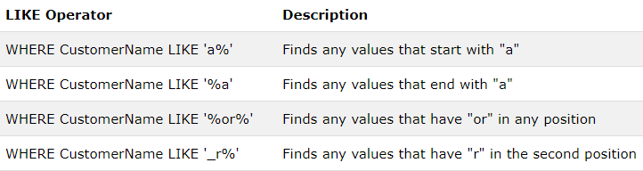
The LIKE operation
The LIKE operator is used in a WHERE clause to search for a specified pattern in a column
There are two wildcards or special characters used in conjunction with the LIKE operator:
% : The percent sign represents zero, one, or multiple characters
_ - The underscore represents a single character
Syntax: SELECT columnN FROM table_name WHERE columnN LIKE pattern;

Slide 24
The BETWEEN operator
The BETWEEN operator selects values within a given range.
The values can be numbers, text, or dates.
The BETWEEN operator is inclusive: begin and end values are included.
Syntax
SELECT column_name(s) FROM table_name WHERE column_name BETWEEN value1 AND value2;
Example
SELECT * FROM Products WHERE ProductName BETWEEN 'Carnarvon Tigers' AND 'Mozzarella di Giovanni' ORDER BY ProductName;

Slide 25
The SET operations
The set operations union, intersect, and except operate on relations and correspond to the relational algebra operations ∪, ∩, −.
Each of the above operations automatically eliminates duplicates
However, to retain all duplicates use the corresponding multiset versions union all, intersect all and except all. Suppose a tuple occurs m times in r and n times in s, then, it occurs:
m + n times in r union all s
min(m, n) times in r intersect all s
max(0, m – n) times in r except all s

Slide 26
The SET operations
The UNION operator is used to combine the result-set of two or more SELECT statements.
Each SELECT statement within UNION must have the same number of columns
The columns must also have similar data types
The columns in each SELECT statement must also be in the same order
Syntax:
SELECT column_name(s) FROM table1 UNION SELECT column_name(s) FROM table2;

Slide 27
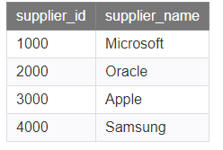
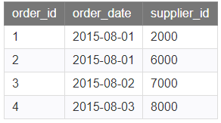
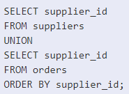
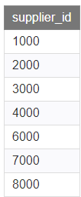
The SET operations

Slide 28
The SET operations
The INTERSECT operator returns the records present in both the tables or relations or both select statements
Each SQL statement within the SQL INTERSECT must have the same number of fields in the result sets with similar data types.
Syntax:
SELECT column_name(s) FROM table1 INTERSECT SELECT column_name(s) FROM table2;

Slide 29
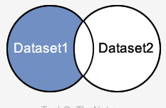
The SET operations
The EXCEPT or MINUS operator return all rows in the first SELECT statement that are not returned by the second SELECT statement
Each SQL statement within the SQL INTERSECT must have the same number of fields in the result sets with similar data types.
Syntax:
SELECT column_name(s) FROM table1 EXCEPT SELECT column_name(s) FROM table2;

Slide 30
Aggregate Functions
An aggregate function is a function where the values of multiple rows are grouped together as input on certain criteria to form a single value of more significant meaning
The most commonly used aggregate functions are:
avg(): returns the average value
sum(): returns the sum of values
count(): return the number of rows
min(): returns the minimum value
max(): returns the maximum value

Slide 31
Aggregate Functions
The COUNT() function returns the number of rows that matches a specified criteria
SELECT COUNT(column_name) FROM table_name WHERE condition;
The AVG() function returns the average value of a numeric column
SELECT AVG(column_name) FROM table_name WHERE condition;
The SUM() function returns the total sum of a numeric column.
SELECT SUM(column_name) FROM table_name WHERE condition;

Slide 32
Aggregate Functions
The MIN() function returns the smallest value of the selected column.
Syntax
SELECT MIN(column_name) FROM table_name WHERE condition;
The MAX() function returns the largest value of the selected column.
Syntax
SELECT MAX(column_name) FROM table_name WHERE condition;

Slide 33
Order BY and Group By clause
The ORDER BY keyword is used to sort the result-set in ascending or descending order.
The ORDER BY keyword sorts the records in ascending order by default.
To sort the records in descending order, use the DESC keyword.
Syntax
SELECT column1, column2, ... FROM table_name ORDER BY column1, column2, ... ASC|DESC;
Example:
SELECT name FROM table_name where age > 20;
ORDER BY name DESC

Slide 34
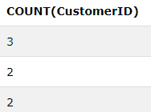
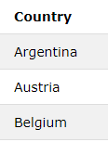
Order BY and Group By clause
The GROUP BY statement is often used with aggregate functions (COUNT, MAX, MIN, SUM, AVG) to group the result-set by one or more columns.
Syntax:
SELECT column_name(s) FROM table_name WHERE condition
GROUP BY column_name(s);
Example: SELECT COUNT(customer_id), Country
FROM Customers
GROUP By Country;

Slide 35
IN and Having
The IN operator checks a value within a set of values which are separated by comma and retrieve the rows from the table which are matching
Syntax:
SELECT column_name(s) FROM table_name WHERE column_name IN (value1, value2, ...);
Example: SELECT * FROM Customers WHERE Country IN ('Germany', 'France', 'UK');
It returns all those rows with country being Germany, France or UK.

Slide 36
IN and Having
The HAVING clause was added to SQL because the WHERE keyword could not be used with aggregate functions.
Syntax:
SELECT COUNT(column_name)
FROM table_name GROUP BY column_name
HAVING condition;
Example: SELECT COUNT(CustomerID), Country FROM Customers GROUP BY Country HAVING COUNT(CustomerID) > 5;

Slide 37
SQL Constraints
Constraints are used to limit the type of data that can go into a table
Constraints can be specified when a table is created (with the CREATE TABLE statement)
Or after the table is created (with the ALTER TABLE statement)
Syntax:
CREATE TABLE table_name ( column1 datatype constraint, column2 datatype constraint, column3 datatype constraint, .... );

Slide 38
Constraints Types
NOT NULL : makes sure that a column does not hold NULL value
UNIQUE: enforces a column or set of columns to have unique values
DEFAULT: provides a default value to a column
CHECK: specifies range of values for a particular column of a table
PRIMARY KEY: Uniquely identifies each row/record in a database table. Must be NOT NULL and UNIQUE
FOREIGN KEY : Uniquely identifies a row/record in another database table.

Slide 39
Constraints Example
CREATE TABLE SCHOOL(
SchoolId int IDENTITY(1,1) PRIMARY KEY,
SchoolName varchar(50) NOT NULL UNIQUE,
Major varchar(10) DEFAULT BBA,
Address varchar(50) NULL,
Phone Bigint
);
CREATE TABLE CLASS(
ClassId int IDENTITY(1,1) PRIMARY KEY,
SchoolId int NOT NULL FOREIGN KEY REFERENCES SCHOOL (SchoolId),
ClassName varchar(50) NOT NULL UNIQUE,
Marks int CHECK(Marks>32)
);

Slide 40
Constraints Example
CREATE TABLE STUDENT(
ROLL_NO INT NOT NULL CHECK(ROLL_NO >10),
STU_NAME VARCHAR (35) UNIQUE,
STU_AGE INT NOT NULL DEFAULT 20,
STU_ADDRESS VARCHAR (35) UNIQUE,
PRIMARY KEY (ROLL_NO)
);
CREATE TABLE Orders ( OrderID int NOT NULL, OrderNumber int NOT NULL, ROLL_NO int, PRIMARY KEY (OrderID), FOREIGN KEY (ROLL_NO) REFERENCES STUDENT(ROLL_NO) );

Slide 41
NULL value
It is possible for tuples to have a null value, denoted by null, for some of their attributes
null signifies an unknown value or that a value does not exist.
The predicate is null can be used to check for null values.
Example: Find all loan number which appear in the loan relation with null values for amount.
select loan_number from loan where amount is null
The result of any arithmetic expression involving null is null
Example: 5 + null returns null
Any comparison with null returns unknown
Example: 5 < null or null > 6 or null = null

Slide 42
SQL JOINS
When data from more than one table is required sql joins are carried out
A JOIN clause is used to combine rows from two or more tables, based on a related column between them
Different Types of SQL JOINs
(INNER) JOIN: Returns records that have matching values in both tables
LEFT (OUTER) JOIN: Return all records from the left table, and the matched records from the right table
RIGHT (OUTER) JOIN: Return all records from the right table, and the matched records from the left table
FULL (OUTER) JOIN: Return all records when there is a match in either left or right table

Slide 43
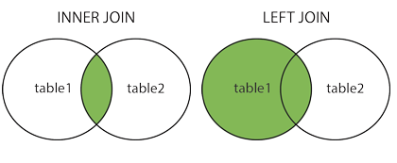
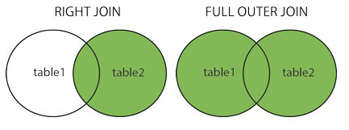
SQL JOINS
Joins in Venn Diagram:

Slide 44
SQL JOINS
Inner Join: The INNER JOIN selects records that have matching values in both tables.
Syntax:
SELECT table1.column1, table2.column2...
FROM table1
INNER JOIN table2
ON table1.common_col = table2.common_col;

Slide 45
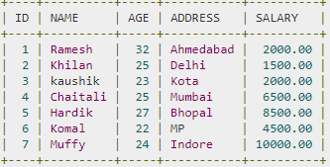
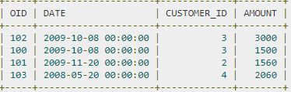
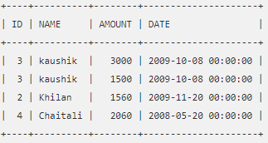
Inner join
Customers
Orders
SELECT ID, NAME, AMOUNT, DATE
FROM CUSTOMERS
INNER JOIN ORDERS
ON CUSTOMERS.ID = ORDERS.CUSTOMER_ID;

Slide 46
SQL JOINS
Left Join: The LEFT JOIN keyword returns all records from the left table (table1), and the matched records from the right table (table2).
Syntax:
SELECT table1.column1, table2.column2...
FROM table1
LEFT JOIN table2
ON table1.common_col = table2.common_col;

Slide 47
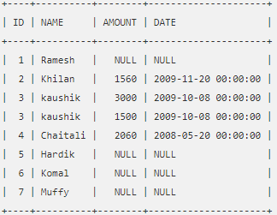
Left join
Customers
Orders
SELECT ID, NAME, AMOUNT, DATE
FROM CUSTOMERS
LEFT JOIN ORDERS
ON CUSTOMERS.ID = ORDERS.CUSTOMER_ID;

Slide 48
SQL JOINS
Right Join: The RIGHT JOIN keyword returns all records from the right table (table2), and the matched records from the left table (table1)
Syntax:
SELECT table1.column1, table2.column2...
FROM table1
RIGHT JOIN table2
ON table1.common_col = table2.common_col;

Slide 49
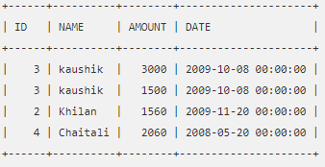
Right join
Customers
Orders
SELECT ID, NAME, AMOUNT, DATE
FROM CUSTOMERS
RIGHT JOIN ORDERS
ON CUSTOMERS.ID = ORDERS.CUSTOMER_ID;

Slide 50
SQL JOINS
Full Join: The FULL JOIN combines the results of both left and right outer joins.
The joined table will contain all records from both the tables and fill in NULLs for missing matches on either side.
Syntax:
SELECT table1.column1, table2.column2...
FROM table1
FULL JOIN table2
ON table1.common_col = table2.common_col;

Slide 51
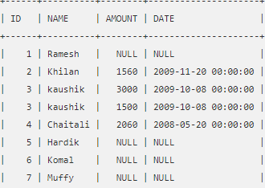
FULL join
Customers
Orders
SELECT ID, NAME, AMOUNT, DATE
FROM CUSTOMERS
FULL JOIN ORDERS
ON CUSTOMERS.ID = ORDERS.CUSTOMER_ID;

Slide 52
CROSS JOIN
Cross Join: The CROSS JOIN produces a result set which is the number of rows in the first table multiplied by the number of rows in the second table. This kind of result is called as Cartesian Product.
An alternative way of achieving the same result is to use column names with SELECT and mentioning the table names involved, after a FROM clause.
Syntax: Alternatively,
SELECT * SELECT * FROM table1, table2;
FROM table1
CROSS JOIN table2;

Slide 53
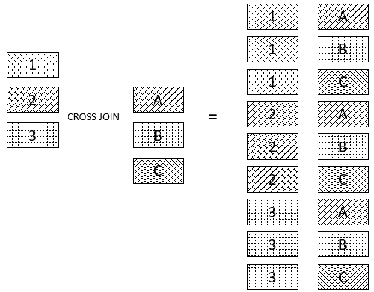
CROSS JOIN
Cross Join:

Slide 54
SQL views
In SQL, a view is a virtual table based on the result-set of an SQL statement.
A view can contain all rows of a table or selected rows from a table.
Views can be created from a single table, multiple tables or another view.
Syntax:
CREATE VIEW view_name AS
SELECT column1, column2.....
FROM table_name
WHERE [condition];

Slide 55
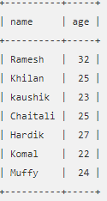
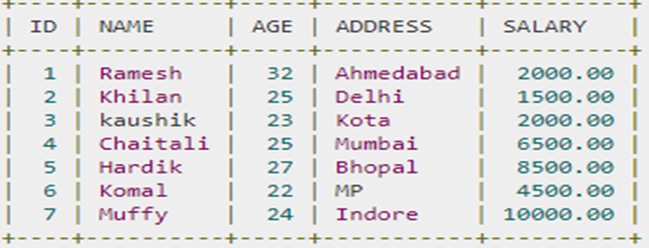
SQL views
CUSTOMERS
CREATE VIEW CUSTOMERS_VIEW AS
SELECT name, age
FROM CUSTOMERS;
CUSTOMERS_VIEW
SELECT * FROM CUSTOMERS_VIEW
DELETE VIEW CUSTOMERS_VIEW (deletes the view created)

Slide 56
SQL views
Operations on Views: To update view
UPDATE CUSTOMERS_VIEW
SET AGE = 35
WHERE name = 'Ramesh';
* This would ultimately update the base table CUSTOMERS and the same would reflect in the view itself
To delete rows:
DELETE FROM CUSTOMERS_VIEW
WHERE age = 22;
*This would ultimately delete the row CUSTOMERS and the same would reflect in the view itself

Slide 57
Nested Subqueries
SQL provides a mechanism for the nesting of subqueries.
A subquery is a select-from-where expression that is nested within another query.
A common use of subqueries is to perform tests for set membership, set comparisons, and set cardinality.
Example:
SELECT COUNT(*) FROM student_table
WHERE marks > (SELECT AVG(marks) FROM student_table);
Returns the number of students scoring higher than the average marks of the class.

Slide 58
Nested Subqueries
Set Membership: The in connective tests for set membership, where the set is a collection of values produced by a select clause.
The not in connective tests for the absence of set membership.
IN (inner query produces a set which is checked for)
select distinct customer-name from borrower
where customer-name IN (select customer-name from depositor)
NOT IN
select distinct customer-name from borrower
where customer-name NOT IN (select customer-name from depositor)

Slide 59
Nested Subqueries
Set Comparison: It allows to compare with the sets. It is done using the comparison operators and keywords all and some
ALL
select branch_name from branch
where assets > all(select assets from branch where branch_city=``Burnaby'')
SOME
select branch_name from branch
where assets > all(select assets from branch where branch_city=``Burnaby'')

Slide 60
Nested Subqueries
Testing for Empty Relations: SQL includes a feature for testing whether a subquery has any tuples in its result.
EXISTS ( return true if the subquery is nonempty)
select customer-name from borrower
where EXISTS (select * from depositor where depositor.customer_name = borrower.customer_name)
NOT EXISTS
select customer-name from borrower
where NOT EXISTS (select * from depositor where depositor.customer_name = borrower.customer_name)

Slide 61
Nested Subqueries
Testing for The Absence of Duplicate Tuples: SQL includes testing whether a subquery has any duplicate tuples in its result.
The unique construct returns the value true if the argument subquery contains no duplicate tuples.
UNIQUE
Find all customers who have at most one account at the
Perryridge branch.
select T.customer-name from depositor as T where unique ( select R.customer-name from account, depositor as R where T.customer-name = R.customer-name and R.account-number = account.account-number and account.branch-name = ‘Perryridge’)

Slide 62
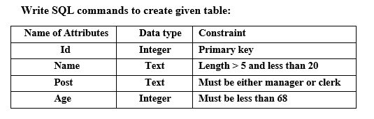
SQL

Slide 63
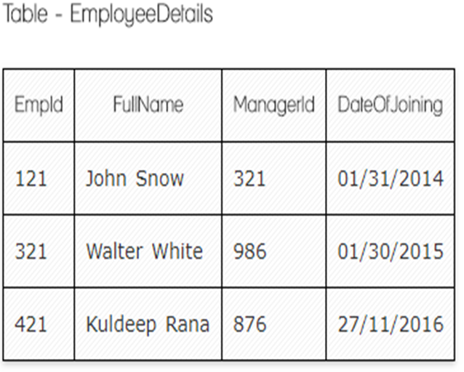
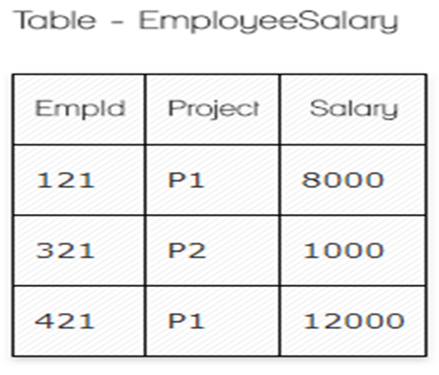
SQL
Ques.1. Write a SQL query to fetch the count of employees working in project 'P1'.
Ques.2. Write a SQL query to fetch employee names having salary greater than or equal to 5000 and less than or equal 10000.
Ques.3. Write a SQL query to fetch project-wise count of employees sorted by project's count in descending order.

Slide 64
SQL
Consider a simple relational database of hospital management system
Doctors (DoctorID, DoctorName, Department, Address, Salary)
Patients (PatientID, Patent Name, Address, Age, Gender)
Hospitals (PatientID, DoctorID, HostpitalName, Location)
Write down the SQL for the following.
Find the name of the doctors whose salaries are greater than average salary of doctors.
Remove record of patient with patient ID = 44.
Find the name of doctor who do not work in Teaching Hospital.
Display id of patients admitted to hospital of Biratnagar and whose name contains exactly 3 characters.
Increase the salary of doctors by 12% who works in General Medicine department.

Slide 65
SQL
Employee (empno, name, office, age)
Books (isbn, title, authors, publisher)
Loan (empno, isbn, date)
Write down the SQL for the following.
Find the name of all employees who have borrowed a book published by McGraw-Hill
(For each publisher, find the name of employees who have borrowed more than five books of that publisher

Slide 66
SQL
Query 1 : List the employee whose employee number is 100.
Query 2 : List the Employee whose salary is between 50 K to 1 Lac.
Query 3 : List the Employees whose name starts with ‘Ami’.
Query 4 : List the Employees whose name starts with A and surname starts with S.
Query 5 : List the Employees whose surname contains kar word.
Query 6: List the Employees whose name starts with P,B,R characters.

Slide 67
SQL
Query 7: List the Employees whose name not starts with P,B,R characters.
Query 8 : What is query to fetch first record from Employee table?
How to find the maximum salary of the employees?
What is SQL Query to find maximum salary of each department?
Find the second highest salary from the table.

Slide 68
SQL
8. Consider a database schema of company.
Employee (employee_name, street, city, age)
Works (employee_name, company_name, salary)
Company (company_name, city)
Managers (employee_name, manager_name)
Where the primary keys are underlined
Write SQL for the following queries
Insert the new record of employee who works for IBM Company located in Darchula.
Find the names and cities of employee who work for the “Deerwalk Company”
Delete the record of employees whose salary >5000.
Increase the salary of employees by 10% on employee relation whose salary is less than 2000.
Find the maximum salary of employee.

Slide 69
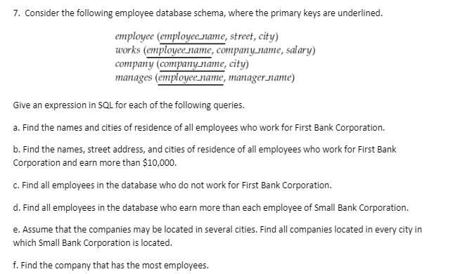
SQL

